Slide 1
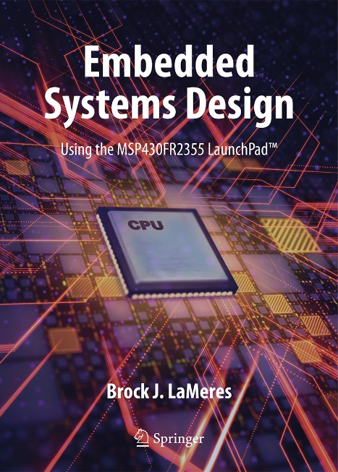

Embedded Systems Design
Chapter 11: Introduction to Interrupts
11.1 The Concept of an Interrupt
Brock J. LaMeres, Ph.D.

Slide 2
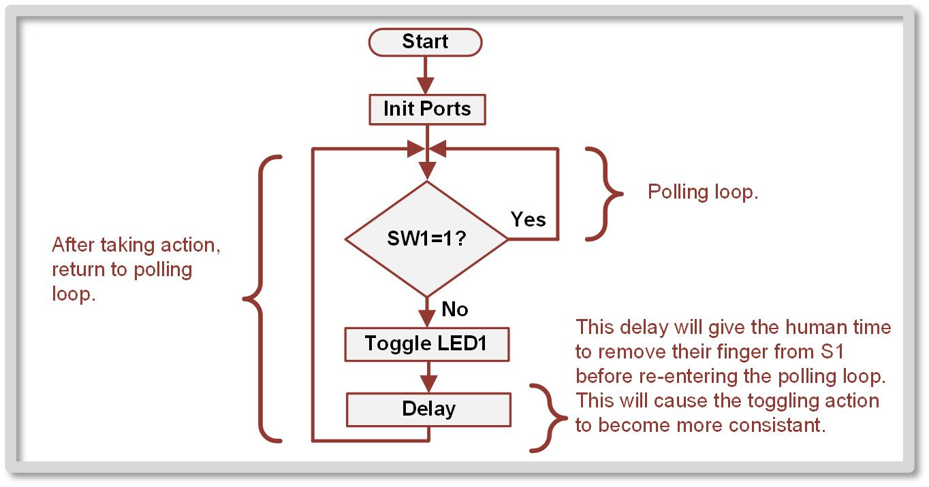
Ch. 11: Introduction to Interrupts
11.1 The Concept of an Interrupt
The Drawback of Polling – CPU spends a lot of time executing instructions that did nothing but actively check for an infrequent event.
11.1 The Concept of an Interrupt

Slide 3
Ch. 11: Introduction to Interrupts
11.1 The Concept of an Interrupt
The Drawback of Polling – CPU spends a lot of time executing instructions that did nothing but actively check for an infrequent event.
Interrupt (IRQ) – an approach to dealing with external, asynchronous events by building hardware int o the MCU that handles identifying and prioritizing events to be serviced by the CPU; only reacts one time when a transition is observed.
11.1 The Concept of an Interrupt

Slide 4
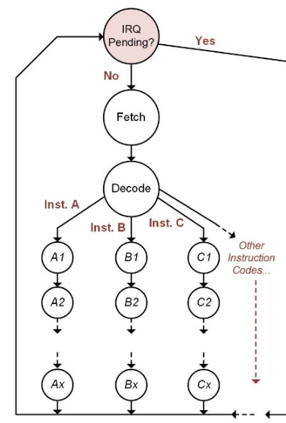
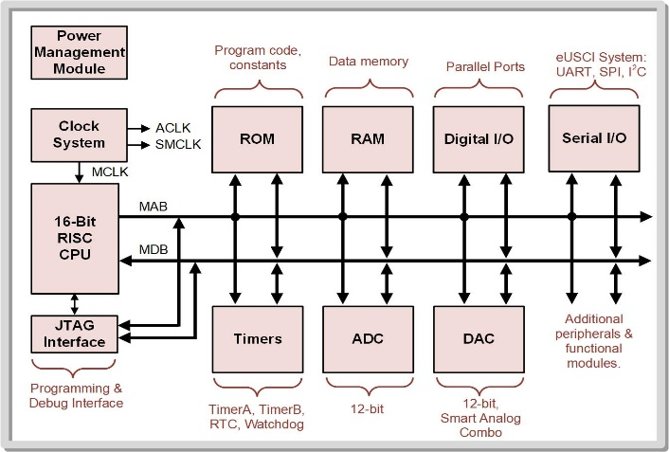
Ch. 11: Introduction to Interrupts
11.1.1 Interrupt Flags (IFG)
Flag – notifies the CPU that an external event on a peripheral has occurred and action is requested.
11.1 The Concept of an Interrupt

Slide 5
Ch. 11: Introduction to Interrupts
11.1.1 Interrupt Flags (IFG)
Flag – notifies the CPU that an external event on a peripheral has occurred and action is requested.
When a flag is observed, the CPU completes its current instruction and then executes a sequence of instructions that accomplishes the desired action for the peripheral.
11.1 The Concept of an Interrupt

Slide 6
Ch. 11: Introduction to Interrupts
11.1.1 Interrupt Flags (IFG)
Flag – notifies the CPU that an external event on a peripheral has occurred and action is requested.
The term interrupt stems from the fact that the CPU takes a break from executing the main program and instead executes instructions specifically for the peripheral event.
11.1 The Concept of an Interrupt

Slide 7
Ch. 11: Introduction to Interrupts
11.1.1 Interrupt Flags (IFG)
Flag – notifies the CPU that an external event on a peripheral has occurred and action is requested.
This process is highly efficient because the CPU does not have to spend execution cycles polling each external system.
11.1 The Concept of an Interrupt

Slide 8
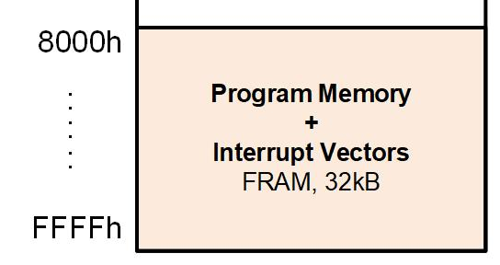
Ch. 11: Introduction to Interrupts
11.1.1 Interrupt Flags (IFG)
Interrupt service routine (ISR) or interrupt handler – the code that is executed when an interrupt occurs
Main Program
Subroutine 1
Subroutine 2
Image Courtesy of
Recording Connection of Canada
ISR 1
Image Courtesy of
Recording Connection of Canada
Image Courtesy of
Recording Connection of Canada
Image Courtesy of
Recording Connection of Canada
Image Courtesy of
Recording Connection of Canada
ISR 2
11.1 The Concept of an Interrupt

Slide 9
Ch. 11: Introduction to Interrupts
11.1.1 Interrupt Flags (IFG)
Interrupt service routine (ISR) or interrupt handler – the code that is executed when an interrupt occurs
Servicing – when the CPU is taking steps to handle the IRQ.
Pending – when an interrupt has asserted its flag but the CPU has not had an opportunity to service it.
Main Program
Subroutine 1
Subroutine 2
Image Courtesy of
Recording Connection of Canada
ISR 1
Image Courtesy of
Recording Connection of Canada
Image Courtesy of
Recording Connection of Canada
Image Courtesy of
Recording Connection of Canada
ISR 2
11.1 The Concept of an Interrupt

Slide 10

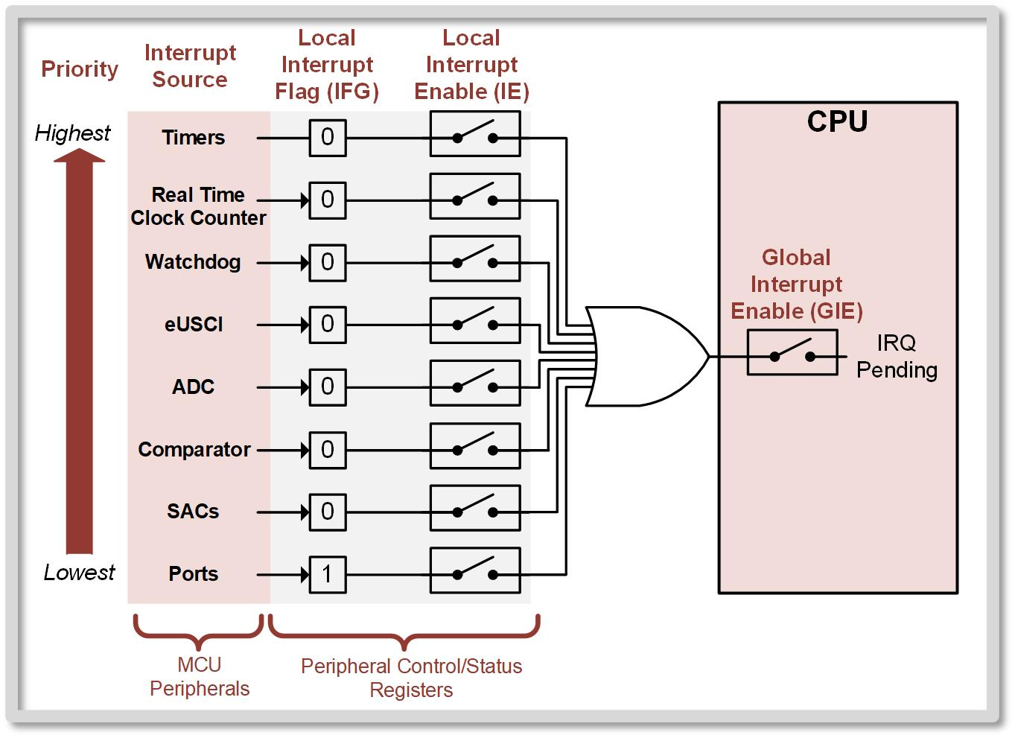
Ch. 11: Introduction to Interrupts
11.1.1 Interrupt Flags (IFG)
The CPU control unit is designed to handle IRQs.
11.1 The Concept of an Interrupt

Slide 11
Ch. 11: Introduction to Interrupts
11.1.2 Interrupt Priority and Enabling
When the CPU is ready to service an interrupt, it always executes the highest priority peripheral first.
11.1 The Concept of an Interrupt

Slide 12
Ch. 11: Introduction to Interrupts
11.1.2 Interrupt Priority and Enabling
When the CPU is ready to service an interrupt, it always executes the highest priority peripheral first.
Once that routine completes, it moves to the next highest priority peripheral that is pending, and so forth.
11.1 The Concept of an Interrupt

Slide 13
Ch. 11: Introduction to Interrupts
11.1.2 Interrupt Priority and Enabling
When the CPU is ready to service an interrupt, it always executes the highest priority peripheral first.
Once that routine completes, it moves to the next highest priority peripheral that is pending, and so forth.
Interrupts can interrupt other interrupts if they have a higher priority, but some restrictions apply that are described in subsequent sections.
11.1 The Concept of an Interrupt

Slide 14

Ch. 11: Introduction to Interrupts
11.1.2 Interrupt Priority and Enabling
Categories of interrupts: 1) System resets, 2) Non-maskable interrupts (NMIs), 3) Maskable interrupts
Image Courtesy of
Recording Connection of Canada
Image Courtesy of
Recording Connection of Canada
Image Courtesy of
Recording Connection of Canada
Image Courtesy of
Recording Connection of Canada
Image Courtesy of
Recording Connection of Canada
Image Courtesy of
Recording Connection of Canada
11.1 The Concept of an Interrupt

Slide 15
Ch. 11: Introduction to Interrupts
11.1.2 Interrupt Priority and Enabling
Categories of interrupts: 1) System resets, 2) Non-maskable interrupts (NMIs), 3) Maskable interrupts
System Resets – highest priority interrupts and are always enabled; causes the MCU to start its operation from the beginning.
System resets include power-on reset (POR), power-up reset (PUR), external reset, and power supply monitor violation.
The only action needed by developer for system resets is to tell the interrupt system where the starting address of the main program is.
Image Courtesy of
Recording Connection of Canada
Image Courtesy of
Recording Connection of Canada
Image Courtesy of
Recording Connection of Canada
Image Courtesy of
Recording Connection of Canada
Image Courtesy of
Recording Connection of Canada
Image Courtesy of
Recording Connection of Canada
11.1 The Concept of an Interrupt

Slide 16
Ch. 11: Introduction to Interrupts
11.1.2 Interrupt Priority and Enabling
Categories of interrupts: 1) System resets, 2) Non-maskable interrupts (NMIs), 3) Maskable interrupts
Non-maskable Interrupts – second highest priority interrupts; typically handle fault conditions on the MCU.
Examples include memory access errors and oscillator faults.
Non-maskable interrupts are always enabled but are different from system resets in that they do execute developer written ISRs instead of a set of predetermined actions.
11.1 The Concept of an Interrupt

Slide 17
Ch. 11: Introduction to Interrupts
11.1.2 Interrupt Priority and Enabling
Categories of interrupts: 1) System resets, 2) Non-maskable interrupts (NMIs), 3) Maskable interrupts
Maskable Interrupts – third highest priority interrupts. These are the peripherals! - ports - timers - serial interface - ADC - DAC
11.1 The Concept of an Interrupt

Slide 18
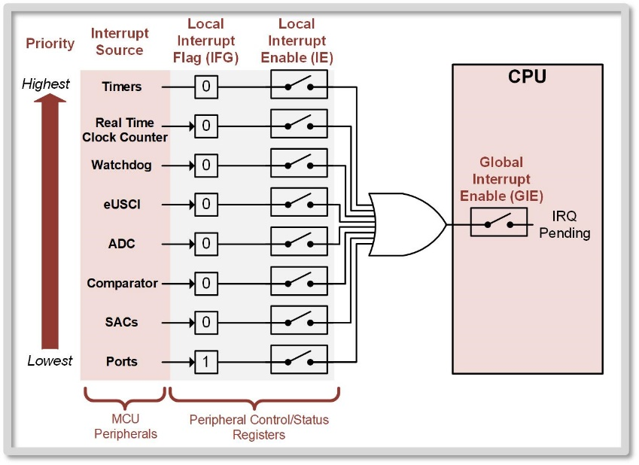
Ch. 11: Introduction to Interrupts
11.1.2 Interrupt Priority and Enabling
Maskable Interrupts - means that they can be turned on or off.
11.1 The Concept of an Interrupt

Slide 19
Ch. 11: Introduction to Interrupts
11.1.2 Interrupt Priority and Enabling
GIE bit – used as the global enable for all maskable interrupts.
GIE = 1 – maskable interrupts enabled
GIE = 0 – maskable interrupts disabled
Enabling and Disabling can be done by simply setting or clearing the GIE bit in the SR using EINT and DINT respectively.
11.1 The Concept of an Interrupt

Slide 20
Ch. 11: Introduction to Interrupts
11.1.2 Interrupt Priority and Enabling
Interrupt Enable (IE) – configured in the control/status registers within the memory map for each peripheral.
Global and local interrupt enable bits can be thought of as gating switches that allow the peripheral’s flag to be observed by the CPU when configured.
11.1 The Concept of an Interrupt

Slide 21

Embedded Systems Design
Chapter 11: Introduction to Interrupts
11.1.2 Interrupt Priority and Enabling
www.youtube.com/c/DigitalLogicProgramming_LaMeres
Brock J. LaMeres, Ph.D.

Slide 22
Embedded Systems Design
Chapter 11: Introduction to Interrupts
11.1.3 Interrupt Vectors
Brock J. LaMeres, Ph.D.

Slide 23
Ch. 11: Introduction to Interrupts
11.1.3 Interrupt Vectors
An Interrupt Service Routine (ISR) is written for any peripheral that is to be handled.
Similar to subroutines.
But different in the way they are called and returned from.
Main Program
ISR 1
ISR 2
11.1 The Concept of an Interrupt

Slide 24
Ch. 11: Introduction to Interrupts
11.1.3 Interrupt Vectors
An Interrupt Service Routine (ISR) is written for any peripheral that is to be handled.
The beginning of an ISR is marked with an address label in the main.asm file. This address label serves as the starting address to be put into the PC when the ISR is called.
Label
Address
RESET:
8000h
Main Program
main:
800Ah
ISR1:
800Eh
ISR 1
ISR2:
8012h
ISR 2
11.1 The Concept of an Interrupt

Slide 25
Ch. 11: Introduction to Interrupts
11.1.3 Interrupt Vectors
An Interrupt Service Routine (ISR) is written for any peripheral that is to be handled.
The beginning of an ISR is marked with an address label in the main.asm file. This address label serves as the starting address to be put into the PC when the ISR is called.
The starting address of the ISR is then put into a dedicated Interrupt Vector. That is associated with the peripheral.
Label
Address
RESET:
8000h
Main Program
main:
800Ah
ISR1:
800Eh
ISR 1
ISR2:
8012h
ISR 2
11.1 The Concept of an Interrupt

Slide 26
Ch. 11: Introduction to Interrupts
11.1.3 Interrupt Vectors
Interrupt Vectors – Each peripheral has a dedicated memory location that holds the starting address of its ISR.
Label
Address
RESET:
8000h
Main Program
main:
800Ah
ISR1:
800Eh
ISR 1
ISR2:
8012h
ISR 2
11.1 The Concept of an Interrupt

Slide 27
Ch. 11: Introduction to Interrupts
11.1.3 Interrupt Vectors
Interrupt Vectors – Each peripheral has a dedicated memory location that holds the starting address of its ISR.
This dedicated location is an “address pointer” of where the ISR starts. (aka, a vector).
Label
Address
RESET:
8000h
Main Program
main:
800Ah
ISR1:
800Eh
ISR 1
ISR2:
8012h
ISR 2
11.1 The Concept of an Interrupt

Slide 28
Ch. 11: Introduction to Interrupts
11.1.3 Interrupt Vectors
Interrupt Vectors – Each peripheral has a dedicated memory location that holds the starting address of its ISR.
This dedicated location is an “address pointer” of where the ISR starts. (aka, a vector).
Since the ISR starting address changes for every program, the developer must initialize the vector using directives when downloaded.
Label
Address
RESET:
8000h
Main Program
main:
800Ah
ISR1:
800Eh
ISR 1
ISR2:
8012h
ISR 2
11.1 The Concept of an Interrupt

Slide 29
Ch. 11: Introduction to Interrupts
11.1.3 Interrupt Vectors
Interrupt Vectors – Each peripheral has a dedicated memory location that holds the starting address of its ISR.
This dedicated location is an “address pointer” of where the ISR starts. (aka, a vector).
Since the ISR starting address changes for every program, the developer must initialize the vector using directives when downloaded.
The vector addresses are hard-coded.
Label
Address
RESET:
8000h
Main Program
main:
800Ah
ISR1:
800Eh
ISR 1
ISR2:
8012h
ISR 2
11.1 The Concept of an Interrupt

Slide 30
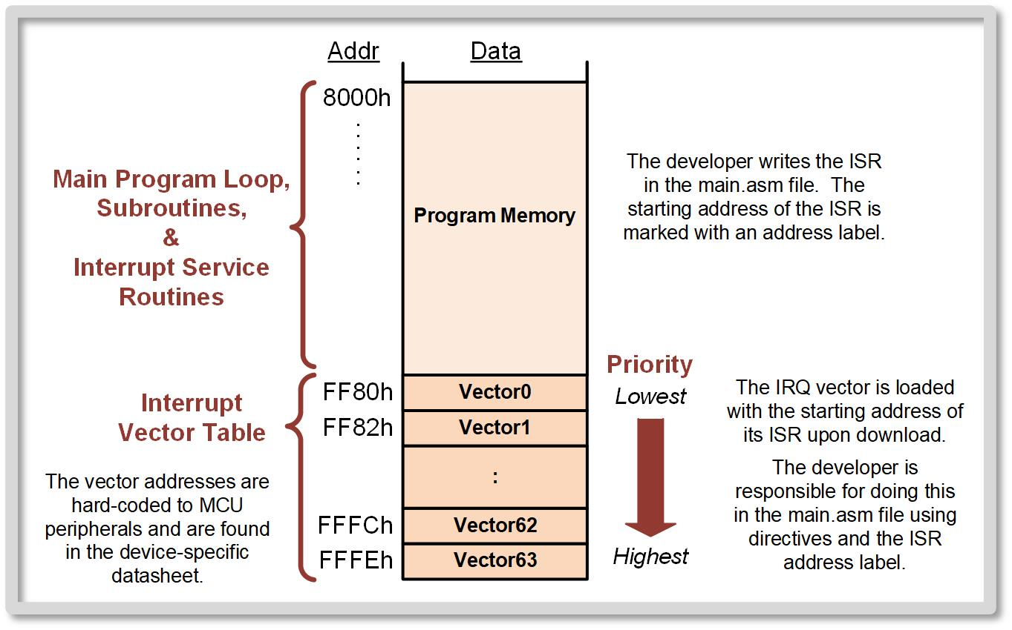
Ch. 11: Introduction to Interrupts
11.1.3 Interrupt Vectors
11.1 The Concept of an Interrupt

Slide 31
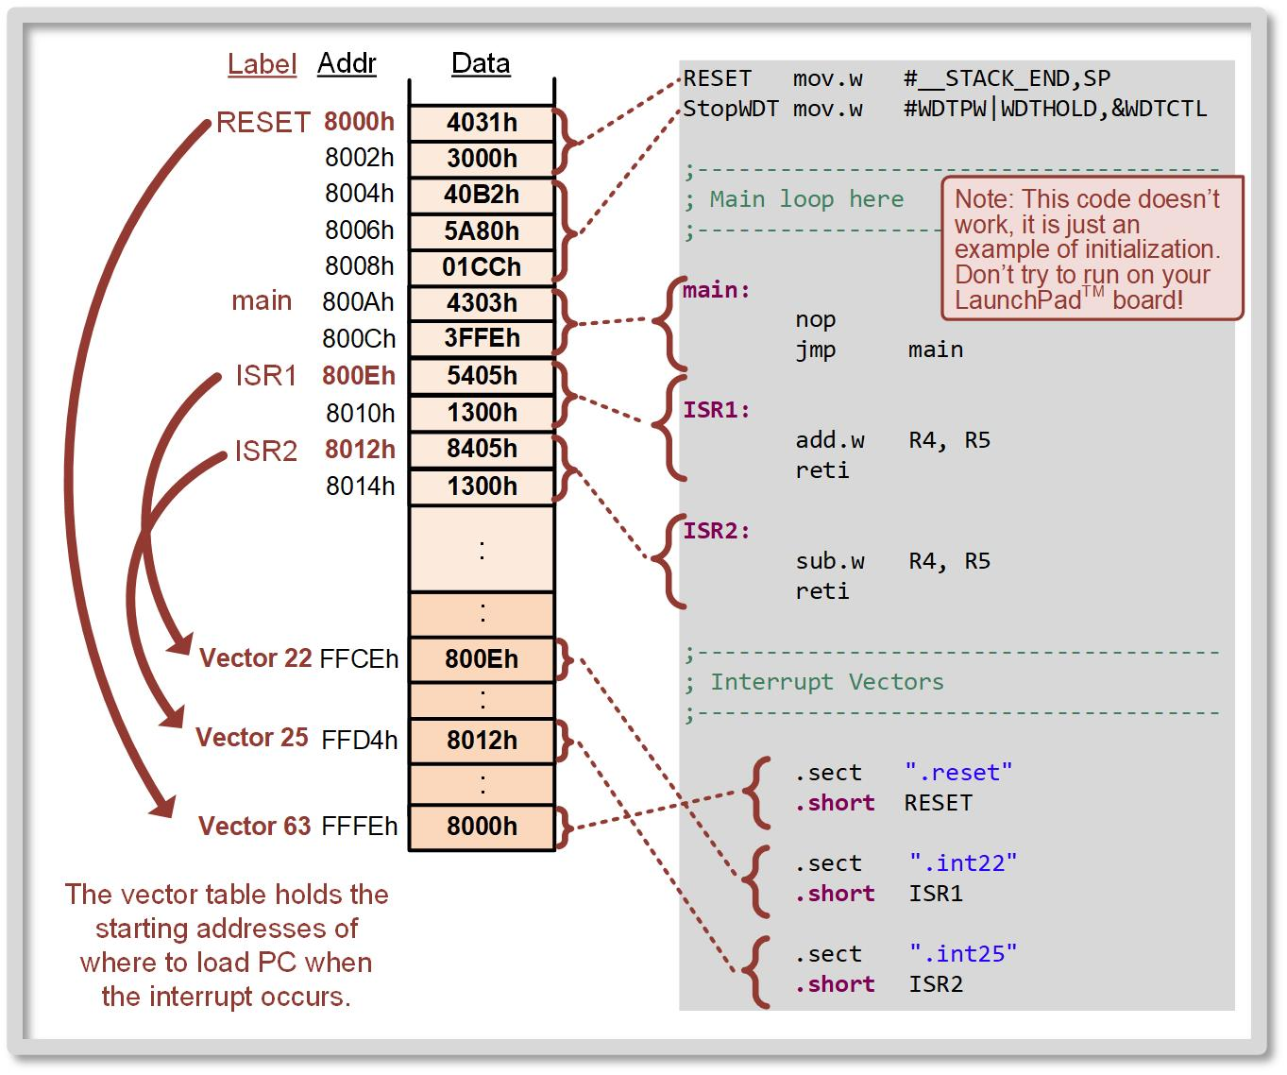
Ch. 11: Introduction to Interrupts
11.1.3 Interrupt Vectors
Let’s see how this might look:
11.1 The Concept of an Interrupt

Slide 32
Ch. 11: Introduction to Interrupts
11.1.3 Interrupt Vectors
Let’s see how this might look:
RESET (vector 63) is where the program starts. Always the highest priority.
11.1 The Concept of an Interrupt

Slide 33
Ch. 11: Introduction to Interrupts
11.1.3 Interrupt Vectors
Let’s see how this might look:
RESET (vector 63) is where the program starts. Always the highest priority.
The .sect and .short directive puts the address into the vector.
11.1 The Concept of an Interrupt

Slide 34
Ch. 11: Introduction to Interrupts
11.1.3 Interrupt Vectors
Let’s see how this might look:
RESET (vector 63) is where the program starts. Always the highest priority.
The .sect and .short directive puts the address into the vector.
.reset is defined in the linker files.
11.1 The Concept of an Interrupt

Slide 35
Ch. 11: Introduction to Interrupts
11.1.3 Interrupt Vectors
Let’s see how this might look:
11.1 The Concept of an Interrupt

Slide 36
Ch. 11: Introduction to Interrupts
11.1.3 Interrupt Vectors
Let’s see how this might look:
Let’s say Vector 22 is a peripheral. We need to put its ISR’s starting address in its corresponding vector address location.
11.1 The Concept of an Interrupt

Slide 37
Ch. 11: Introduction to Interrupts
11.1.3 Interrupt Vectors
Let’s see how this might look:
Let’s say Vector 22 is a peripheral. We need to put its ISR’s starting address in its corresponding vector address location.
The .sect and .short directive puts the address into the vector.
11.1 The Concept of an Interrupt

Slide 38
Ch. 11: Introduction to Interrupts
11.1.3 Interrupt Vectors
Let’s see how this might look:
Let’s say Vector 22 is a peripheral. We need to put its ISR’s starting address in its corresponding vector address location.
The .sect and .short directive puts the address into the vector.
.int22 is defined in the linker files.
11.1 The Concept of an Interrupt

Slide 39
Ch. 11: Introduction to Interrupts
11.1.3 Interrupt Vectors
Let’s see how this might look:
11.1 The Concept of an Interrupt

Slide 40
Ch. 11: Introduction to Interrupts
11.1.3 Interrupt Vectors
Let’s see how this might look:
Let’s say Vector 25 is a peripheral. We need to put its ISR’s starting address in its corresponding vector address location.
11.1 The Concept of an Interrupt

Slide 41
Ch. 11: Introduction to Interrupts
11.1.3 Interrupt Vectors
Let’s see how this might look:
Let’s say Vector 25 is a peripheral. We need to put its ISR’s starting address in its corresponding vector address location.
The .sect and .short directive puts the address into the vector.
11.1 The Concept of an Interrupt

Slide 42
Ch. 11: Introduction to Interrupts
11.1.3 Interrupt Vectors
Let’s see how this might look:
Let’s say Vector 25 is a peripheral. We need to put its ISR’s starting address in its corresponding vector address location.
The .sect and .short directive puts the address into the vector.
.int25 is defined in the linker files.
11.1 The Concept of an Interrupt

Slide 43
Ch. 11: Introduction to Interrupts
11.1.3 Interrupt Vectors
The full MSP430 architecture supports up to 64 separate interrupt vectors whose addresses are located within the range FF80h → FFFFh.
Not all are active in every MCU.
11.1 The Concept of an Interrupt

Slide 44
Embedded Systems Design
Chapter 11: Introduction to Interrupts
11.1.3 Interrupt Vectors
www.youtube.com/c/DigitalLogicProgramming_LaMeres
Brock J. LaMeres, Ph.D.

Slide 45
Embedded Systems Design
Chapter 11: Introduction to Interrupts
11.1.4 Operation of the STACK During an IRQ
Brock J. LaMeres, Ph.D.

Slide 46
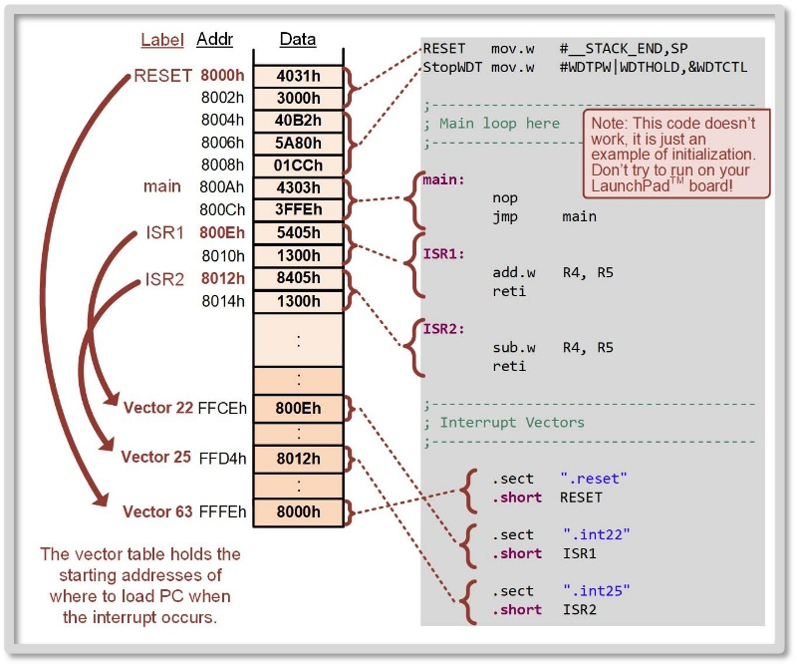
Ch. 11: Introduction to Interrupts
11.1.4 Operation of the STACK during an IRQ
When an IRQ is to be serviced:
11.1 The Concept of an Interrupt

Slide 47
Ch. 11: Introduction to Interrupts
11.1.4 Operation of the STACK during an IRQ
When an IRQ is to be serviced:
CPU finishes its current instruction.
11.1 The Concept of an Interrupt

Slide 48
Ch. 11: Introduction to Interrupts
11.1.4 Operation of the STACK during an IRQ
When an IRQ is to be serviced:
CPU finishes its current instruction.
The next instruction in main program is put into PC.
11.1 The Concept of an Interrupt

Slide 49
Ch. 11: Introduction to Interrupts
11.1.4 Operation of the STACK during an IRQ
When an IRQ is to be serviced:
CPU finishes its current instruction.
The next instruction in main program is put into PC.
PC and SR are pushed to stack.
11.1 The Concept of an Interrupt

Slide 50
Ch. 11: Introduction to Interrupts
11.1.4 Operation of the STACK during an IRQ
When an IRQ is to be serviced:
CPU finishes its current instruction.
The next instruction in main program is put into PC.
PC and SR are pushed to stack.
MCU clears the SR so that it can be used by the ISR.
11.1 The Concept of an Interrupt

Slide 51
Ch. 11: Introduction to Interrupts
11.1.4 Operation of the STACK during an IRQ
When an IRQ is to be serviced:
CPU finishes its current instruction.
The next instruction in main program is put into PC.
PC and SR are pushed to stack.
MCU clears the SR so that it can be used by the ISR.
MCU retrieves starting address of ISR from the interrupt vector and loads it into PC.
11.1 The Concept of an Interrupt

Slide 52
Ch. 11: Introduction to Interrupts
11.1.4 Operation of the STACK during an IRQ
When an IRQ is to be serviced:
CPU finishes its current instruction.
The next instruction in main program is put into PC.
PC and SR are pushed to stack.
MCU clears the SR so that it can be used by the ISR.
MCU retrieves starting address of ISR from the interrupt vector and loads it into PC.
Execute ISR.
11.1 The Concept of an Interrupt

Slide 53
Ch. 11: Introduction to Interrupts
11.1.4 Operation of the STACK during an IRQ
When an IRQ is to be serviced:
CPU finishes its current instruction.
The next instruction in main program is put into PC.
PC and SR are pushed to stack.
MCU clears the SR so that it can be used by the ISR.
MCU retrieves starting address of ISR from the interrupt vector and loads it into PC.
Execute ISR.
CPU pops the SR and PC from the stack.
11.1 The Concept of an Interrupt

Slide 54
Ch. 11: Introduction to Interrupts
11.1.4 Operation of the STACK during an IRQ
When an IRQ is to be serviced:
CPU finishes its current instruction.
The next instruction in main program is put into PC.
PC and SR are pushed to stack.
MCU clears the SR so that it can be used by the ISR.
MCU retrieves starting address of ISR from the interrupt vector and loads it into PC.
Execute ISR.
CPU pops the SR and PC from the stack.
Main program runs from where it left off.
11.1 The Concept of an Interrupt

Slide 55
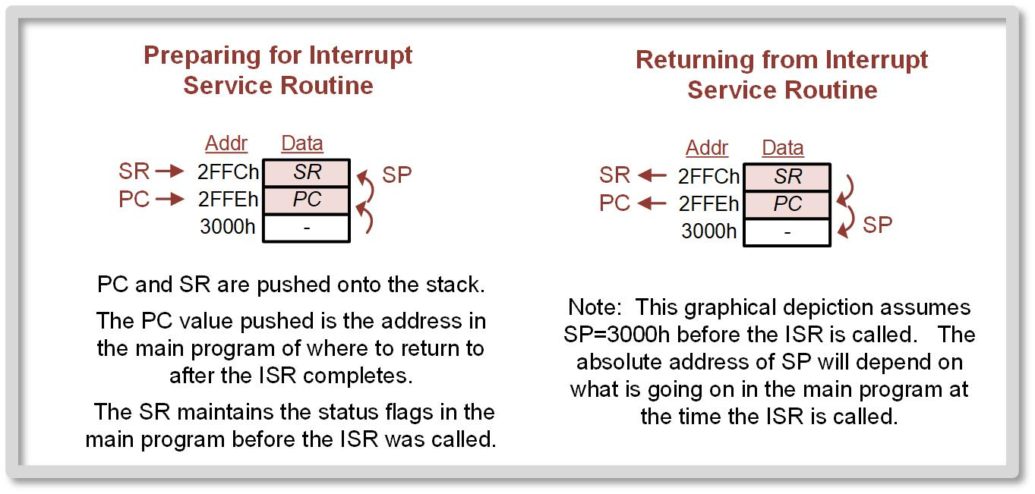
Ch. 11: Introduction to Interrupts
11.1.4 Operation of the STACK during an IRQ
11.1 The Concept of an Interrupt

Slide 56
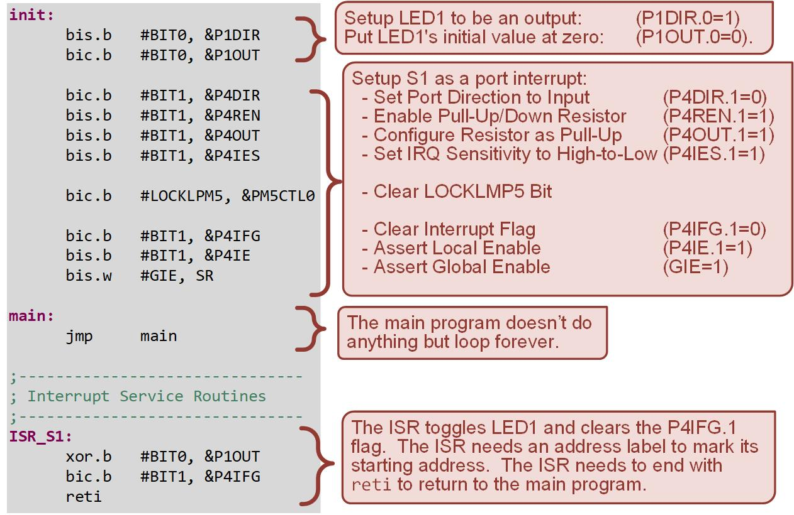
Ch. 11: Introduction to Interrupts
11.1.5 Interrupt Service Routines (ISR)
Return From Interrupt (reti) – Always the final instruction in an ISR; pops the SR and PC off the stack in order to return the CPU execution back to the main program.
CRITICAL!!!
11.1 The Concept of an Interrupt

Slide 57
Ch. 11: Introduction to Interrupts
11.1.5 Interrupt Service Routines (ISR)
Return From Interrupt (reti) – Always the final instruction in an ISR; pops the SR and PC off the stack in order to return the CPU execution back to the main program.
Anther critical role of a maskable ISR is that it must clear the peripheral’s local interrupt flag (IFG) that caused the interrupt in the first place. Else, the interrupt will continually run because the flag is still asserted.
If you forget, the IRQ will continuously trigger.
11.1 The Concept of an Interrupt

Slide 58
Ch. 11: Introduction to Interrupts
11.1.5 Interrupt Service Routines (ISR)
Return From Interrupt (reti) – Always the final instruction in an ISR; pops the SR and PC off the stack in order to return the CPU execution back to the main program.
Anther critical role of a maskable ISR is that it must clear the peripheral’s local interrupt flag (IFG) that caused the interrupt in the first place. Else, the interrupt will continually run because the flag is still asserted.
ISRs should be short, fast, and dedicated to only performing the functionality needed by the peripheral at that time.
Don’t put too much in an ISR
11.1 The Concept of an Interrupt

Slide 59

Ch. 11: Introduction to Interrupts
11.1.6 Nested Interrupts
Maskable interrupts are disabled while executing an ISR because GIE = 0.
Image Courtesy of https://neodem.wp.horizon.ac.uk/
Image Courtesy of
Recording Connection of Canada
Image Courtesy of
Recording Connection of Canada
Image Courtesy of
Recording Connection of Canada
Image Courtesy of
Recording Connection of Canada
Image Courtesy of
Recording Connection of Canada
Image Courtesy of
Recording Connection of Canada
Image Courtesy of
Recording Connection of Canada
11.1 The Concept of an Interrupt

Slide 60
Ch. 11: Introduction to Interrupts
11.1.6 Nested Interrupts
Maskable interrupts are disabled while executing an ISR because GIE = 0.
Once the ISR completes and the SR is popped off the stack, the original value of GIE = 1 is restored and maskable interrupts are again enabled when the CPU returns to the main program.
Image Courtesy of https://neodem.wp.horizon.ac.uk/
Image Courtesy of
Recording Connection of Canada
Image Courtesy of
Recording Connection of Canada
Image Courtesy of
Recording Connection of Canada
Image Courtesy of
Recording Connection of Canada
Image Courtesy of
Recording Connection of Canada
Image Courtesy of
Recording Connection of Canada
Image Courtesy of
Recording Connection of Canada
11.1 The Concept of an Interrupt

Slide 61
Ch. 11: Introduction to Interrupts
11.1.6 Nested Interrupts
Maskable interrupts are disabled while executing an ISR because GIE = 0.
Once the ISR completes and the SR is popped off the stack, the original value of GIE = 1 is restored and maskable interrupts are again enabled when the CPU returns to the main program.
System resets and non-maskable interrupts can always interrupt other lower priority ISRs because they are not enabled by GIE.
Image Courtesy of https://neodem.wp.horizon.ac.uk/
Image Courtesy of
Recording Connection of Canada
Image Courtesy of
Recording Connection of Canada
Image Courtesy of
Recording Connection of Canada
Image Courtesy of
Recording Connection of Canada
Image Courtesy of
Recording Connection of Canada
Image Courtesy of
Recording Connection of Canada
Image Courtesy of
Recording Connection of Canada
11.1 The Concept of an Interrupt

Slide 62
Ch. 11: Introduction to Interrupts
11.1.6 Nested Interrupts
Creating nested maskable ISRs is not recommended because it can lead to stack overflow or infinite ISR loops.
Image Courtesy of https://neodem.wp.horizon.ac.uk/
Image Courtesy of
Recording Connection of Canada
Image Courtesy of
Recording Connection of Canada
Image Courtesy of
Recording Connection of Canada
Image Courtesy of
Recording Connection of Canada
Image Courtesy of
Recording Connection of Canada
Image Courtesy of
Recording Connection of Canada
Image Courtesy of
Recording Connection of Canada
11.1 The Concept of an Interrupt

Slide 63
Ch. 11: Introduction to Interrupts
11.1.6 Nested Interrupts
Creating nested maskable ISRs is not recommended because it can lead to stack overflow or infinite ISR loops.
A better approach is to create ISRs that are short and fast and then rely on the MCU’s prioritization scheme to allow higher priority interrupts to be serviced while lower priority interrupts wait in the pending state until the CPU is ready to act on them.
Image Courtesy of https://neodem.wp.horizon.ac.uk/
Image Courtesy of
Recording Connection of Canada
Image Courtesy of
Recording Connection of Canada
Image Courtesy of
Recording Connection of Canada
Image Courtesy of
Recording Connection of Canada
Image Courtesy of
Recording Connection of Canada
Image Courtesy of
Recording Connection of Canada
Image Courtesy of
Recording Connection of Canada
11.1 The Concept of an Interrupt

Slide 64
Embedded Systems Design
Chapter 11: Introduction to Interrupts
11.1.6 Nested IRQ
www.youtube.com/c/DigitalLogicProgramming_LaMeres
Brock J. LaMeres, Ph.D.

Slide 65
Embedded Systems Design
Chapter 11: Introduction to Interrupts
11.1.7 IRQ Servicing Summary & The Developer’s Responsibility
Brock J. LaMeres, Ph.D.

Slide 66
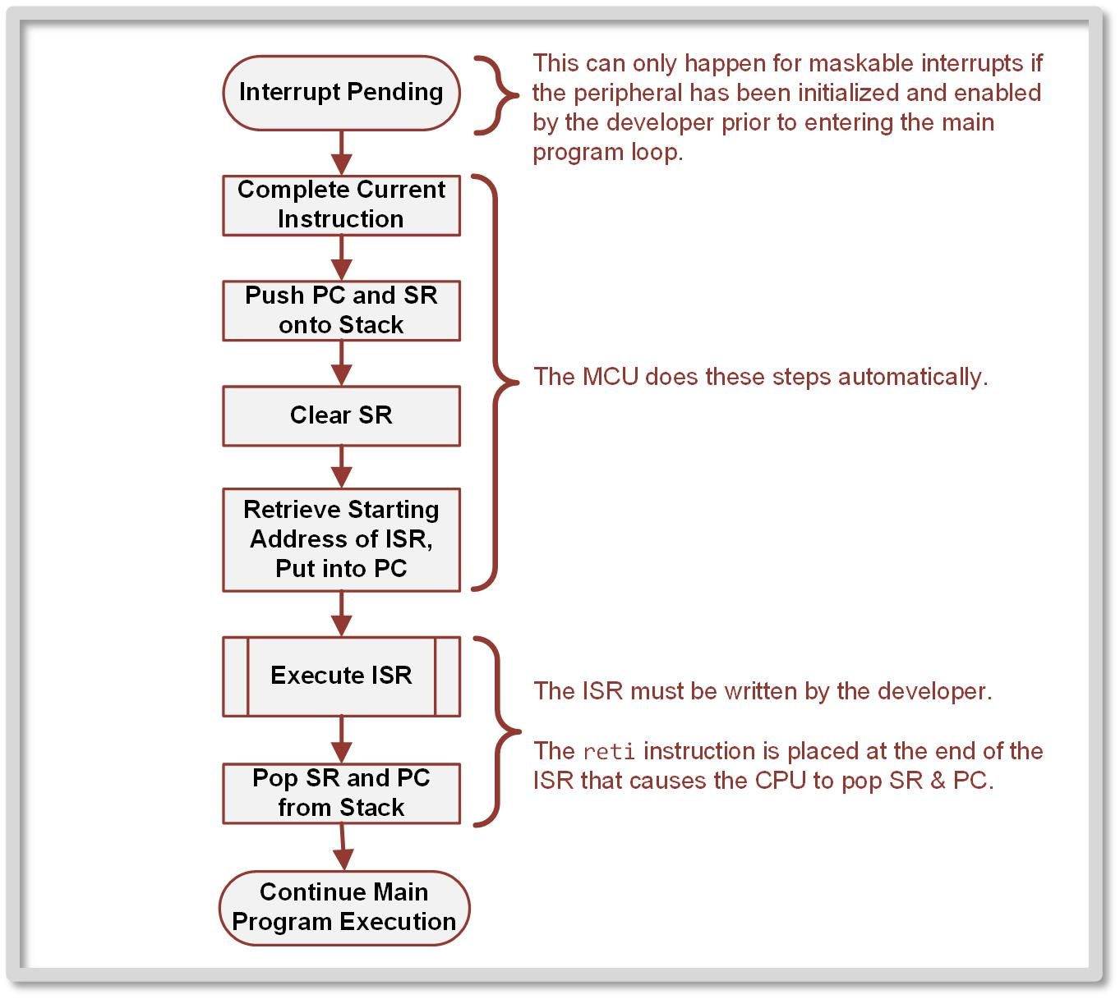
Ch. 11: Introduction to Interrupts
11.1.7 Interrupt Servicing Summary
Note that some of the steps are taken automatically by the CPU while some are up to the developer.
11.1 The Concept of an Interrupt

Slide 67
Ch. 11: Introduction to Interrupts
11.1.7 Interrupt Servicing Summary
When using a specific peripheral with a maskable interrupt, the developer has the following responsibilities:
11.1 The Concept of an Interrupt

Slide 68
Ch. 11: Introduction to Interrupts
11.1.7 Interrupt Servicing Summary
When using a specific peripheral with a maskable interrupt, the developer has the following responsibilities:
Configure the peripheral for the desired functionality.
11.1 The Concept of an Interrupt

Slide 69
Ch. 11: Introduction to Interrupts
11.1.7 Interrupt Servicing Summary
When using a specific peripheral with a maskable interrupt, the developer has the following responsibilities:
Configure the peripheral for the desired functionality.
Clear the peripheral’s interrupt flag.
11.1 The Concept of an Interrupt

Slide 70
Ch. 11: Introduction to Interrupts
11.1.7 Interrupt Servicing Summary
When using a specific peripheral with a maskable interrupt, the developer has the following responsibilities:
Configure the peripheral for the desired functionality.
Clear the peripheral’s interrupt flag.
Assert the local interrupt enable (IE) for the peripheral.
11.1 The Concept of an Interrupt

Slide 71
Ch. 11: Introduction to Interrupts
11.1.7 Interrupt Servicing Summary
When using a specific peripheral with a maskable interrupt, the developer has the following responsibilities:
Configure the peripheral for the desired functionality.
Clear the peripheral’s interrupt flag.
Assert the local interrupt enable (IE) for the peripheral.
Assert the global interrupt enable (GIE) in the status register.
11.1 The Concept of an Interrupt

Slide 72
Ch. 11: Introduction to Interrupts
11.1.7 Interrupt Servicing Summary
When using a specific peripheral with a maskable interrupt, the developer has the following responsibilities:
Configure the peripheral for the desired functionality.
Clear the peripheral’s interrupt flag.
Assert the local interrupt enable (IE) for the peripheral.
Assert the global interrupt enable (GIE) in the status register.
Write the ISR with an address label to mark its starting location and the reti instruction to denote its end. Remember that the ISR must clear the peripheral doesn’t inadvertently trigger another IRQ.
11.1 The Concept of an Interrupt

Slide 73
Ch. 11: Introduction to Interrupts
11.1.7 Interrupt Servicing Summary
When using a specific peripheral with a maskable interrupt, the developer has the following responsibilities:
Configure the peripheral for the desired functionality.
Clear the peripheral’s interrupt flag.
Assert the local interrupt enable (IE) for the peripheral.
Assert the global interrupt enable (GIE) in the status register.
Write the ISR with an address label to mark its starting location and the reti instruction to denote its end. Remember that the ISR must clear the peripheral doesn’t inadvertently trigger another IRQ.
Initialize the vector address for the peripheral using the ISR address label and assembler directives.
11.1 The Concept of an Interrupt

Slide 74
Embedded Systems Design
Chapter 11: Introduction to Interrupts
11.1.7 IRQ Servicing Summary & The Developer’s Responsibility
www.youtube.com/c/DigitalLogicProgramming_LaMeres
Brock J. LaMeres, Ph.D.

Slide 75
Embedded Systems Design
Chapter 11: Introduction to Interrupts
11.1.8 MSP430FR2355 Interrupts
Brock J. LaMeres, Ph.D.

Slide 76

Ch. 11: Introduction to Interrupts
11.1.8 MSP430FR2355 Interrupts
The MSP430FR2355 implements 25 unique interrupt vector addresses. These are grouped into Resets, NMIs, and Maskable.
Multiple peripherals will SHARE a vector address. If more than one is enabled, then functionality must be placed in the ISR to first determine which flag has been asserted and then execute the appropriate service routine code.
11.1 The Concept of an Interrupt

Slide 77
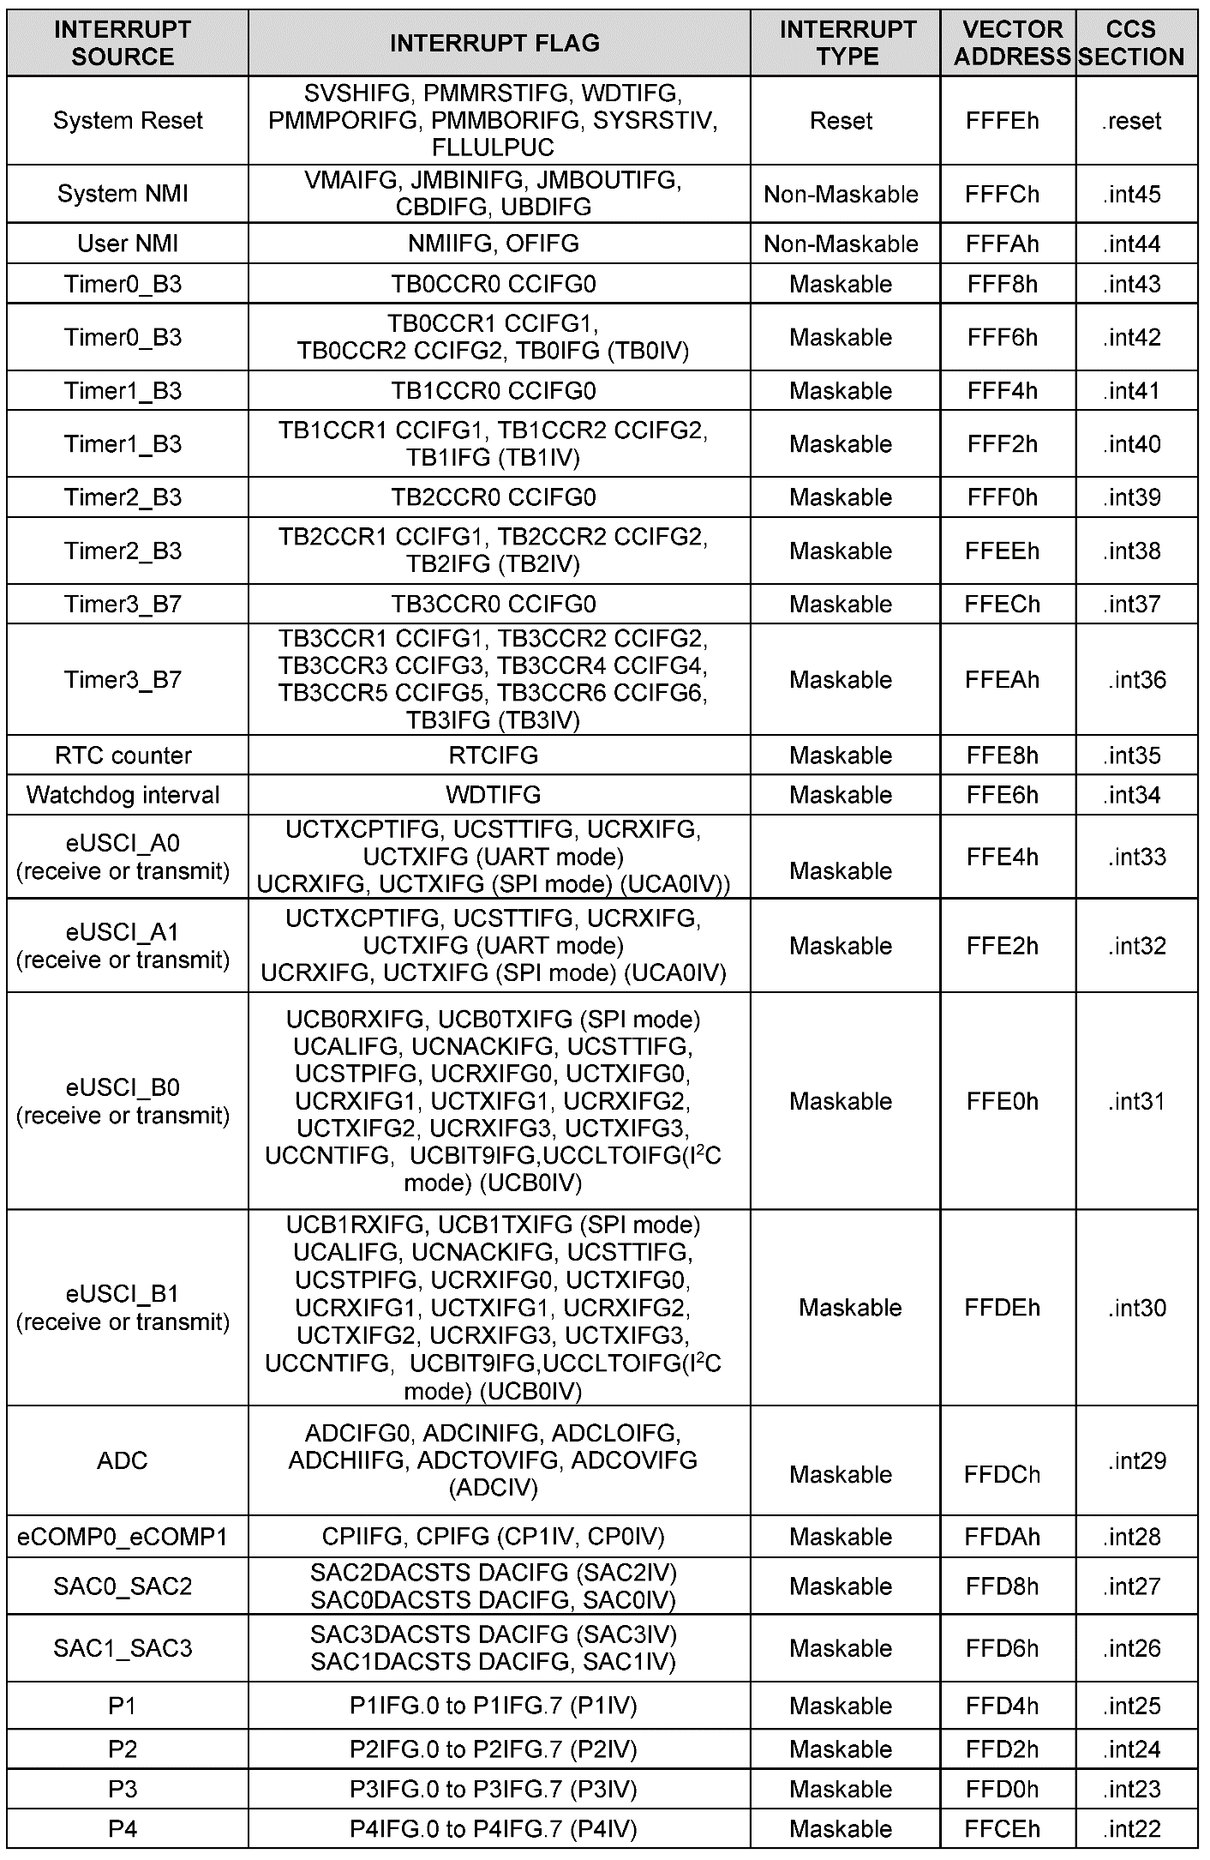
Ch. 11: Introduction to Interrupts
11.1.8 MSP430FR2355 Interrupts
The highest priority vector address implemented (FFFEh) is dedicated to resets.
This vector is always initialized with the starting address of program memory.
In the case of the MSP430FR2355, PC is set to 8000h, which is the beginning of non-volatile FRAM program memory.
11.1 The Concept of an Interrupt

Slide 78
Ch. 11: Introduction to Interrupts
11.1.8 MSP430FR2355 Interrupts
The second and third highest priority addresses implemented (FFFCh and FFFAh) are dedicated to non-maskable interrupts.
The vector FFFCh is used for system non-maskable interrupts, which are hardware-level failures such as accessing memory addresses that don’t have systems mapped to them, memory access timing errors, and memory bit-error detection.
The vector FFFAh is used for user non-maskable interrupts, which include an external input trigger and oscillator faults.
system
user
11.1 The Concept of an Interrupt

Slide 79
Ch. 11: Introduction to Interrupts
11.1.8 MSP430FR2355 Interrupts
Both NMI interrupt vectors execute ISRs when triggered, so it’s the developer’s responsibility to ensure the ISRs exist and the vector addresses are initialized.
The ISRs for the NMIs are often omitted due to the low likelihood of a system failure.
Proceed at your own risk!
11.1 The Concept of an Interrupt

Slide 80

Ch. 11: Introduction to Interrupts
11.1.8 MSP430FR2355 Interrupts
The remaining 22 interrupt vectors are used for maskable interrupts.
Only enabled by the developer.
The MSP430FR2355 assigns:
8x to timers
1x to the real time clock counter
1x for the watchdog timer
4x for the serial communication system
1x for the ADC
1x for the comparator
2x for the smart analog combo DACs
4x for the digital I/O ports.
11.1 The Concept of an Interrupt

Slide 81
Ch. 11: Introduction to Interrupts
11.1.8 MSP430FR2355 Interrupts
11.1 The Concept of an Interrupt

Slide 82
Ch. 11: Introduction to Interrupts
11.1.8 MSP430FR2355 Interrupts
11.1 The Concept of an Interrupt

Slide 83
Ch. 11: Introduction to Interrupts
11.1.8 MSP430FR2355 Interrupts (things to consider)
Vectors are shared across multiple peripherals.
11.1 The Concept of an Interrupt

Slide 84
Ch. 11: Introduction to Interrupts
11.1.8 MSP430FR2355 Interrupts (things to consider)
The flag names correspond to the MSP430 datasheet.
11.1 The Concept of an Interrupt

Slide 85
Ch. 11: Introduction to Interrupts
11.1.8 MSP430FR2355 Interrupts (things to consider)
For every peripheral, you need to look up the configuration register/bit names
11.1 The Concept of an Interrupt

Slide 86
Ch. 11: Introduction to Interrupts
11.1.8 MSP430FR2355 Interrupts (things to consider)
These are the section names we use when initializing the vector table.
11.1 The Concept of an Interrupt

Slide 87
Embedded Systems Design
Chapter 11: Introduction to Interrupts
11.1.8 MSP430FR2355 Interrupts
www.youtube.com/c/DigitalLogicProgramming_LaMeres
Brock J. LaMeres, Ph.D.

Slide 88
Embedded Systems Design
Chapter 11: Introduction to Interrupts
11.2 MSP430FR2355 Port Interrupts - Overview
Brock J. LaMeres, Ph.D.

Slide 89
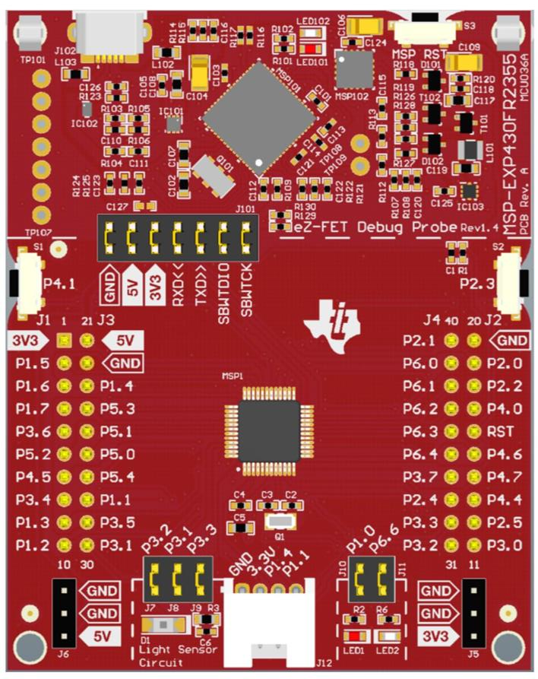
Ch. 11: Introduction to Interrupts
11.2 MSP430FR2355 Port Interrupts
Ports 1→4:
Trigger an interrupt when configured as an input and there’s a transition on its pin.
Each bit on within each port all share the port’s vector.
Developer must determine which bit triggered the interrupt manually and which part of the associated ISR to execute to service that bit.
11.2 MSP430FR2355 Port Interrupts

Slide 90
Ch. 11: Introduction to Interrupts
11.2 MSP430FR2355 Port Interrupts
Port Px Interrupt Enable (PxIE) – local enable for the port interrupts.
PxIE = 0 – interrupt disabled
PxIE = 1 – interrupt enabled
PxIE is cleared on reset, disabling all port interrupts.
Since port interrupts are maskable, the global interrupt for all bits is the GIE in the status register.
11.2 MSP430FR2355 Port Interrupts

Slide 91
Ch. 11: Introduction to Interrupts
11.2 MSP430FR2355 Port Interrupts
Port Px Interrupt Flag (PxIFG) – flags for the port interrupts.
PxIFG = 0 – flag unasserted
PxIE = 1 – flag asserted
PxIFG = 0 upon reset.
Once a port IRQ is serviced, the bit’s flag needs to be cleared in PxIFG by the developer.
11.2 MSP430FR2355 Port Interrupts

Slide 92
Ch. 11: Introduction to Interrupts
11.2 MSP430FR2355 Port Interrupts
Port Px Interrupt Vector Word (PxIV) – used to indicate the priority when simultaneous port IRQs have occurred.
PxIV is loaded with a unique number corresponding to the bit that just triggered an IRQ w/ automatic priority.
The values it takes on represent which of the 8 inputs is pending with the highest priority: bit0 = 02h, bit1 = 04h, bit2 = 06h, bit3 = 08h, bit4 = 0Ah, bit5 = 0Ch, bit6 = 0Eh, and bit7 = 10h.
11.2 MSP430FR2355 Port Interrupts

Slide 93
Ch. 11: Introduction to Interrupts
11.2 MSP430FR2355 Port Interrupts
Port Px Interrupt Vector Word (PxIV) cont…
This register is read-only; however, any access to PxIV (either read or write) will clear port interrupt flag in PxIFG corresponding to the highest priority being displayed in PxIV.
Once the highest priority flag is cleared, it’s expected that the ISR will complete and the next highest priority flag will trigger and the next highest priority bit will be serviced within the same vector address.
Note that using this prioritization feature is optional and the developer can simply use PxIFG to determine which port bit has triggered the interrupt and which one to service first.
11.2 MSP430FR2355 Port Interrupts

Slide 94
Ch. 11: Introduction to Interrupts
11.2 MSP430FR2355 Port Interrupts
Port Px Interrupt Edge (PxIES) – ability to select which transition polarity triggers the interrupt.
PxIES = 0 – triggers on a low-to-high transition of the pin
PxIE = 1 – triggers on a high-to-low transition of the pin
11.2 MSP430FR2355 Port Interrupts

Slide 95
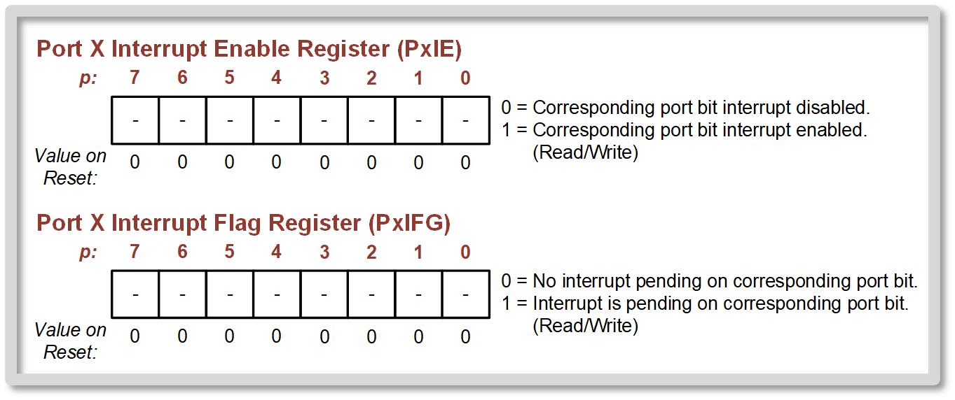
Ch. 11: Introduction to Interrupts
11.2 MSP430FR2355 Port Interrupts
11.2 MSP430FR2355 Port Interrupts

Slide 96
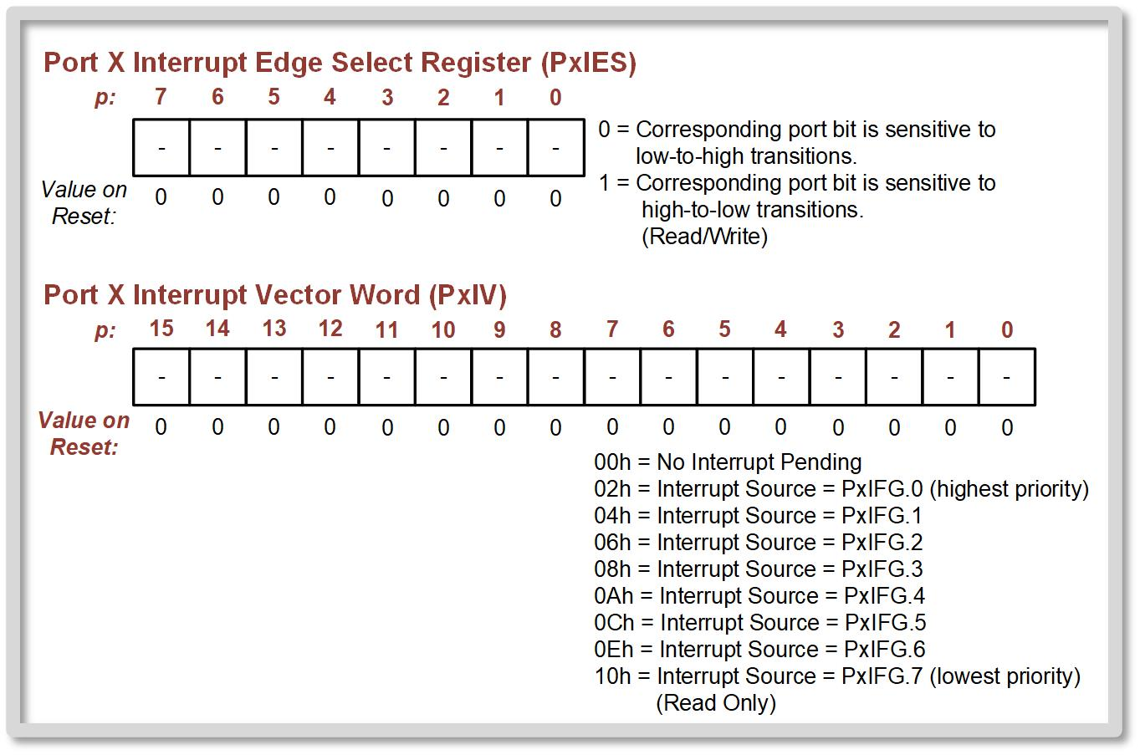
Ch. 11: Introduction to Interrupts
11.2 MSP430FR2355 Port Interrupts
11.2 MSP430FR2355 Port Interrupts

Slide 97
Embedded Systems Design
Chapter 11: Introduction to Interrupts
11.2 MSP430FR2355 Port Interrupts Overview
www.youtube.com/c/DigitalLogicProgramming_LaMeres
Brock J. LaMeres, Ph.D.

Slide 98
Embedded Systems Design
Chapter 11: Introduction to Interrupts
11.2 MSP430FR2355 Port Interrupts – Reading S1 Example
Brock J. LaMeres, Ph.D.

Slide 99
Ch. 11: Introduction to Interrupts
11.2 Configuring S1 to Toggle LED when Pressed
S1 is connected to port 4 bit 1. While the logic level of S1 can be observed on P4IN.1, when using an interrupt, we don’t have to look at this bit. We instead allow a transition to assert an interrupt flag and have the CPU execute an ISR accordingly.
11.2 MSP430FR2355 Port Interrupts

Slide 100
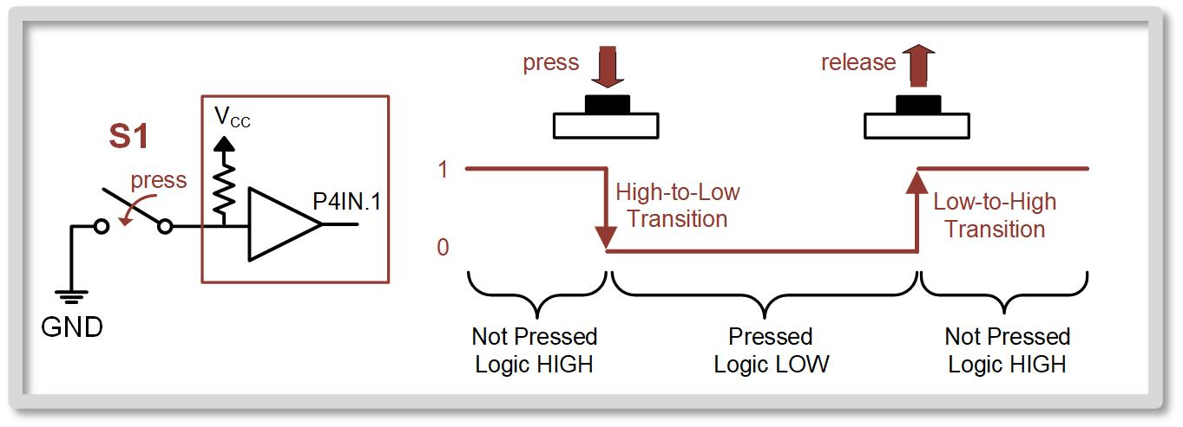
Ch. 11: Introduction to Interrupts
11.2 Configuring S1 to Toggle LED when Pressed
S1 is an SPST switch that is connected to ground. This means we need a pull-up resistor on the MCU to provide the logic HIGH state when S1 is not pressed.
Image Courtesy of
Recording Connection of Canada
Image Courtesy of
Recording Connection of Canada
Image Courtesy of
Recording Connection of Canada
Image Courtesy of
Recording Connection of Canada
Image Courtesy of
Recording Connection of Canada
Image Courtesy of
Recording Connection of Canada
Image Courtesy of
Recording Connection of Canada
11.2 MSP430FR2355 Port Interrupts

Slide 101
Ch. 11: Introduction to Interrupts
11.2 Configuring S1 to Toggle LED when Pressed
If we want the IRQ to trigger immediately upon a button press, then we need to configure the interrupt edge sensitivity (P4IES.1) to be high-to-low. When S1 is not pressed, P4.1 is at a logic high. When the button is pressed, P4.1 goes to a logic low. If we leave the P4IES.1 sensitivity at its default value of low-to-high sensitivity, the interrupt will only trigger once S1 is released.
11.2 MSP430FR2355 Port Interrupts

Slide 102
Ch. 11: Introduction to Interrupts
11.2 Initialization Sequence
Configure Peripheral: - Initialize the port direction (PxDIR) - Initialize pull-up/down resistor (PxREN) - Initialize pull-up/down resistor polarity (PxOUT) - Initialize port interrupt edge select (PxIES).
Clear LOCKLPM5 bit.
Enable the Interrupt - Clear the port interrupt flags (PxIFG). - Assert the local port interrupt enable (PxIE). - Assert the global enable for maskable interrupts (GIE bit in SR).
11.2 MSP430FR2355 Port Interrupts

Slide 103
Ch. 11: Introduction to Interrupts
11.2 Configuring S1 to Toggle LED when Pressed
Since we are only using one bit within P4 to trigger an IRQ, we don’t need to use the P4IV register to determine the highest priority bit that caused the IRQ. We will simply use the P4IFG register knowing that we only care about bit1.
11.2 MSP430FR2355 Port Interrupts

Slide 104
Ch. 11: Introduction to Interrupts
11.2 Creating the Interrupt Service Routine
Our ISR will simply toggle LED1.
Key things to remember - start the ISR with an address label (used when initializing the vector table) - clear the IRQ flag (P4IFG.1). - return with RETI
11.2 MSP430FR2355 Port Interrupts

Slide 105
Ch. 11: Introduction to Interrupts
11.2 Initializing the Vector Table
The port 4 interrupt vector address is FFCEh. This has a CCS section name of .int22. This is the name we will use when we initialize the vector address using assembler directives.
11.2 MSP430FR2355 Port Interrupts

Slide 106
Ch. 11: Introduction to Interrupts
Example: Using a Port Interrupt on S1 to Toggle LED1
Step 1: Create a new Empty Assembly-only CCS project titled:
Asm_IRQs_Port4_S1
Step 2: Type in the following code into the main.asm file where the comments say “Main loop here.”
Image Courtesy of https://neodem.wp.horizon.ac.uk/
Image Courtesy of
Recording Connection of Canada
Image Courtesy of
Recording Connection of Canada
Image Courtesy of
Recording Connection of Canada
Image Courtesy of
Recording Connection of Canada
Image Courtesy of
Recording Connection of Canada
Image Courtesy of
Recording Connection of Canada
Image Courtesy of
Recording Connection of Canada
11.2 MSP430FR2355 Port Interrupts

Slide 107
Ch. 11: Introduction to Interrupts
Example: Using a Port Interrupt on S1 to Toggle LED1
11.2 MSP430FR2355 Port Interrupts

Slide 108
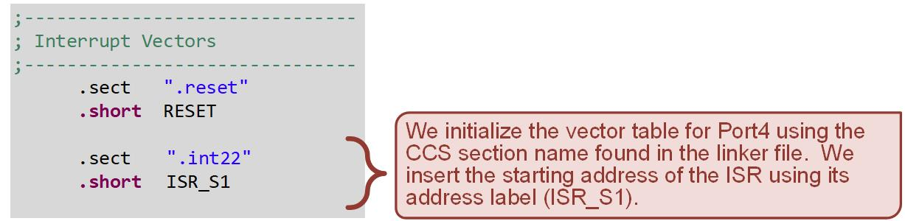
Ch. 11: Introduction to Interrupts
Example: Using a Port Interrupt on S1 to Toggle LED1
11.2 MSP430FR2355 Port Interrupts

Slide 109
Ch. 11: Introduction to Interrupts
Example: Using a Port Interrupt on S1 to Toggle LED1
Step 3: Debug your program
Step 4: Run your program. You will see LED1 toggle anytime S1 is pressed.
Image Courtesy of https://neodem.wp.horizon.ac.uk/
Image Courtesy of
Recording Connection of Canada
Image Courtesy of
Recording Connection of Canada
Image Courtesy of
Recording Connection of Canada
Image Courtesy of
Recording Connection of Canada
Image Courtesy of
Recording Connection of Canada
Image Courtesy of
Recording Connection of Canada
Image Courtesy of
Recording Connection of Canada
11.2 MSP430FR2355 Port Interrupts

Slide 110
Ch. 11: Introduction to Interrupts
Ex: Observing Low-to-High Port IRQ Sensitivity on S1
Step 1: Create a new Empty Assembly-only CCS project titled:
Asm_IRQs_Port4_S1n
Step 2: Copy your code from your last program “Asm_IRQs_Port4_S1” into your new project.
Step 3: Save and debug your program to verify it still works as in the last example.
Image Courtesy of https://neodem.wp.horizon.ac.uk/
Image Courtesy of
Recording Connection of Canada
Image Courtesy of
Recording Connection of Canada
Image Courtesy of
Recording Connection of Canada
Image Courtesy of
Recording Connection of Canada
Image Courtesy of
Recording Connection of Canada
Image Courtesy of
Recording Connection of Canada
Image Courtesy of
Recording Connection of Canada
11.2 MSP430FR2355 Port Interrupts

Slide 111
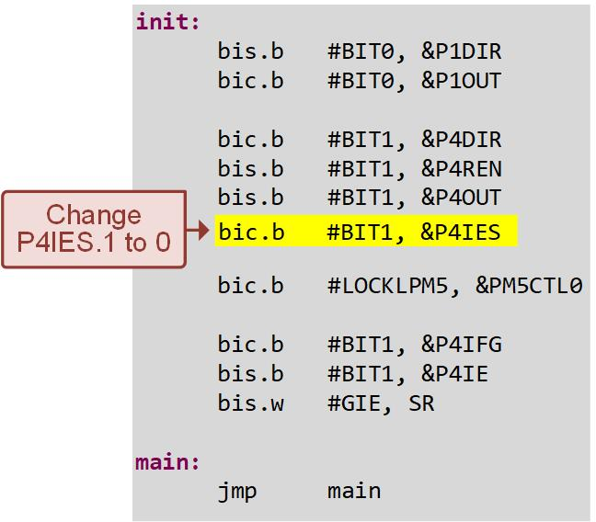
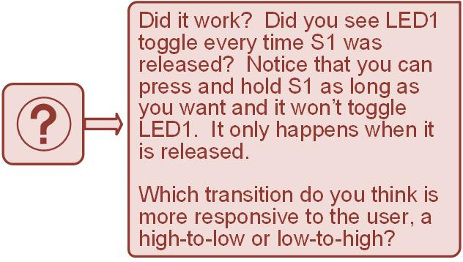
Ch. 11: Introduction to Interrupts
Ex: Observing Low-to-High Port IRQ Sensitivity on S1
Step 4: Change your setting for your P4IES.1 to a zero.
Step 5: Save and debug your program. Run it and observe the new functionality.
11.2 MSP430FR2355 Port Interrupts

Slide 112
Ch. 11: Introduction to Interrupts
Ex: Observing the Impact of Not Clearing the IRQ Flag
Step 1: Open your last example project:
Asm_IRQs_Port4_S1n
Step 2: In your ISR, comment out the instruction that clears the P4IFG.1 flag.
Step 3: Save and debug your program. Set a breakpoint at the first instruction in your ISR. Run your program.
Image Courtesy of https://neodem.wp.horizon.ac.uk/
Image Courtesy of
Recording Connection of Canada
Image Courtesy of
Recording Connection of Canada
Image Courtesy of
Recording Connection of Canada
Image Courtesy of
Recording Connection of Canada
Image Courtesy of
Recording Connection of Canada
Image Courtesy of
Recording Connection of Canada
Image Courtesy of
Recording Connection of Canada
11.2 MSP430FR2355 Port Interrupts

Slide 113
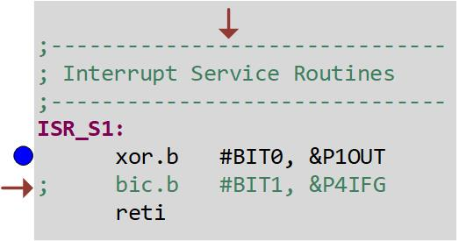
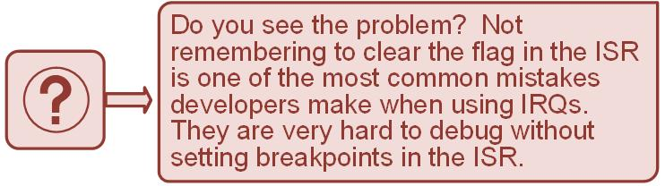
Ch. 11: Introduction to Interrupts
Ex: Observing the Impact of Not Clearing the IRQ Flag
Step 4: Now press and release S1. Your program will run to the breakpoint in your ISR and pause.
Step 5: Now step your program. You will see that the ISR continually triggers and you can never get out of it.
11.2 MSP430FR2355 Port Interrupts

Slide 114
Embedded Systems Design
Chapter 11: Introduction to Interrupts
11.2 MSP430FR2355 Port Interrupts – Reading S1 Example
www.youtube.com/c/DigitalLogicProgramming_LaMeres
Brock J. LaMeres, Ph.D.

